Slide 1
TRADING BOT REQUIREMENTS

Slide 2
USER INPUT VARIABLES
breakout_lines – in contract value (defined every day)
breakout_tolerance – in points
wick_tolerance – in percentage
risk_per_trade – in $
max_candle_body_size – in points
stop_loss_historical_candles – in # of candles (just an int…)
stop_loss_wg_room – in points

Slide 3
PROCESS
TRADING TAKES PLACE ONLY FROM 9:30 am – 10:00 am ET (candle starting at 10:00 am does NOT count)
5 MIN CANDLE CHART
NO TRADES ARE EXECUTED IF BREAKOUT LINES ARE NOT DEFINED!
TRADES ARE EXECUTED ONLY AT END OF EACH CANDLE (5 MIN INTERVALS)

Slide 4
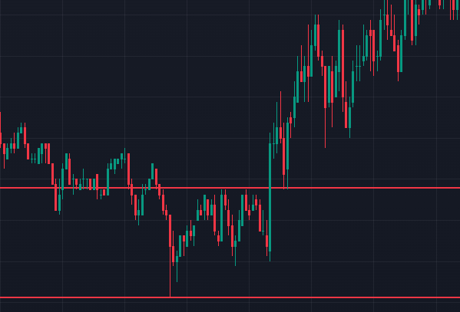
PRICE BREAKOUT
a candle breaks a breakout line => distance (in points) of candle price close is higher than breakout_tolerance
Ex. breakout_tolerance is set to 5 points (defined by user); breakout lines are defined by user (red lines ); candle body size above breakout line = 8 pts.; 8 > 5 => VALID BREAKOUT
8 pts 8 > 5

Slide 5
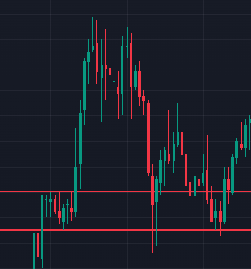
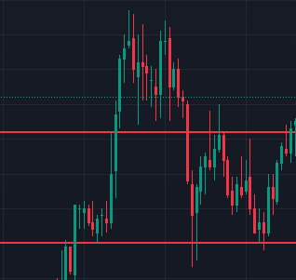
PRICE BREAKOUT
Percentage of a breakout candle wick ABOVE/BELOW a breakout line is smaller than wick_tolerance
In case of a non valid breakout; the broken breakout line will be moved to the top/bottom of the wick ex. wick_tolerance is set to 50%; candle size above breakout line = 20 pts.; wick = 12 pts. (60%); body = 8 pts. (40%) => NOT A VALID BREAKOUT => breakout line is moved to top of wick…
12 pts.
8 pts.

Slide 6
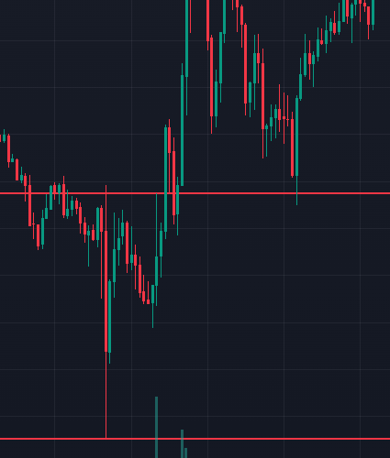
PRICE BREAKOUT
size (opening price to closing price) of a breakout candle is smaller than max_candle_body_size
If a candle breaks a breakout line and it’s body exceeds max_candle_body_size before any trade is executed no more trading is done for the day (session); if a candle’s body exceeds the max_candle body size but does not break a breakout line nothing happens… ex. max_candle_body_size is set to 150 points; candle size = 176 pts.; 176 > 150 => NOT A VALID BREAKOUT
176 pts.

Slide 7
CONTRACT VOLUME
# of contracts is calculated based on risk_per_trade
Actual amount of contracts is rounded to the closest whole number
In practice, actual risk per trade CAN be higher than risk_per_trade
Ex. stop loss is set at 23$ per contract; risk_per_trade is set to 120$. => 120/23 = 5.217 ≈ 5; actual risk = 115$ Ex. Stop loss is set at 23$ per contract; risk_per_trade is set to 155$
=> 155/23 = 6.74 ≈ 7; actual risk = 161$

Slide 8
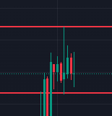
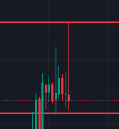
BREAKOUT LINE BEHAVIOR
If a candle’s wick breaks a breakout line and no trades are placed, the breakout line will be moved to the top/bottom of said wick
Breakout line updates take place at 5 minute intervals (when the candle closes..)
No more than 2 breakout lines exist at a time
Ex. breakout lines are set before market open (pic. 1); the following candle breaks the breakout line, but only with it’s wick => the breakout line is moved to the top of the wick

Slide 9
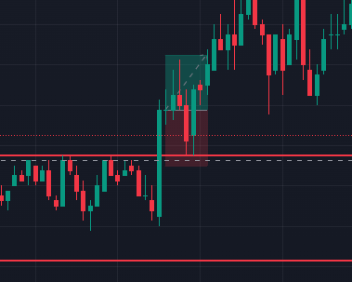
SL & TP
Stop losses (SL) and Take profits (TP) are defined and set by the algorithm
SL is calculated based on a candle whose BODY is closest to a broken breakout line (the whole body has to be within breakout lines…)
Amount of historical candles considered is stop_loss_historical_candles
SL is set by stop_loss_wg_room amount of points above/below candle body
P/L RATIO is 1:1 => TP and SL are the same distance from entry price
Ex. Stop_loss_historical_candles is set to 10; stop_loss_wg_room is set to 1
Closest candle body to breakout line
Candles considered for SL

